Slide 1
GROUP-1 ONLINE EVENT MANAGEMENT SYSTEM

Slide 2
Presented By:
2634687-Abhishek E U
2634054-Dausab Gari Shaik Salman Basha
2634217-Kancharla Jahnavi Durga
2634804-L Priya
2634820-Pallapothu Bhanu Ganesh Kumar
2634577-Pallavi Agrawal

Slide 3
Overview
Application for users and organizers to manage events online easily.
Users can register to book events at various available venues.
Organizers can list their properties as venues.
Users can check available venues, costs, food items, and equipment online.
Organizers can keep records of events booked at their venues.
The system provides transparency by displaying venue details and standard costs.
Users receive a user ID upon registration and can log in using a password.
Logged-in users can manage their dashboard, view notifications, booking history, and payment details.

Slide 4
ABSTRACT
Eventify is a feature-rich web-based event management system that makes it easier to create, browse, register, and manage events. The platform supports a variety of user roles, such as administrators, organizers, and attendees. While organizers are empowered to design, maintain, and oversee their events in a seamless environment, attendees can easily browse and sign up for events that pique their interest. The admin module of the system makes sure that platform operations are effectively monitored and managed By offering a user-friendly interface, strong backend capabilities, and effective event classification and registration procedures, Eventify seeks to improve user experience and enable seamless, scalable event administration.
4

Slide 5
Technologies & Tools Used
Frontend Framework The frontend is built with Angular, providing a dynamic and responsive user interface.
Backend Framework Spring Boot is leveraged for the backend, facilitating the creation of RESTful APIs.
Database Management MySQL serves as the database management system, ensuring efficient data storage.
Deployment The application is deployed on Tomcat, ensuring stability and scalability.

Slide 6
User Types & Their Functions
Attendees:
Browse venues, register, and make payments.
View dashboard with booking history and feedback options.
Organizers:
List venues and create/manage events.
Track bookings and events.
Admins:
Manage users including attendees and organizers.
Oversee all events and venues on the platform.
5

Slide 7
Attendee Features
User Registration:
Attendees can easily sign up to access the platform and gain personalized access to event information and services.
Event Browsing:
They can search and filter events by category, date, and location, making it simple to find events that match their interests.
Event Booking:
Attendees can book events directly online, selecting preferred venues and services with secure payment options.
Profile Management:
They can update their personal information, track their booking history, and manage preferences to enhance their user experience.
Notifications:
Attendees receive real-time notifications about booking confirmations, payment status, event updates, and reminders to stay informed throughout the process.

Slide 8
Organizer Features in OEMS
Venue & Event Management:
Organizers can register to list their properties as venues and create/manage multiple events on the platform.
Booking & Record Keeping:
They track all event bookings made for their venues and maintain detailed records to ensure efficient management.
Smooth Operations:
They ensure seamless event management by coordinating venue details, services, and customer interactions within the system.

Slide 9
Admin Module Overview
Event Management:
Admins can create, edit, and delete events, managing all event details to ensure accuracy and relevance on the platform.
User Management:
The admin module includes features for managing user accounts, enabling admins to suspend or delete accounts if necessary.
Content Moderation:
Admins can review and moderate user-generated content, ensuring compliance with community standards and guidelines.

Slide 10
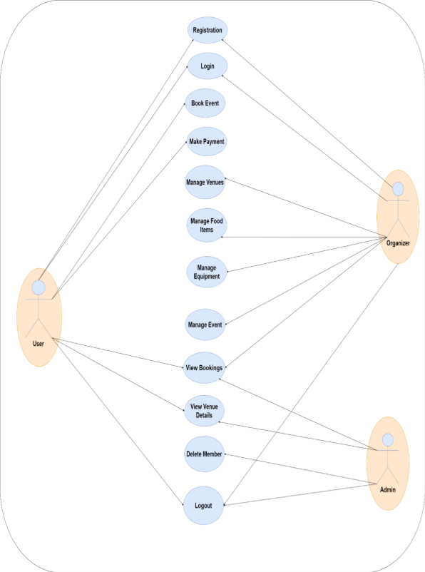
Schematic Diagram

Slide 11
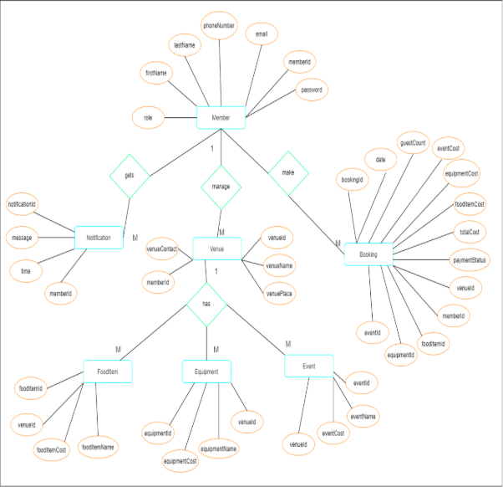
ER Diagram

Slide 12
Future Enhancements
Mobile Application:
Plans to develop a mobile app to improve user accessibility and engagement on smartphones and tablets.
Real-Time Notifications: Introducing real-time push notifications for updates on bookings, payments, and event reminders.
Social Media Integration: Enabling users to share events and feedback directly on social media platforms to increase reach and engagement.
Multi-Language Support: Expanding the platform to support multiple languages for wider user accessibility.

Slide 13
Conclusion
The Online Event Management System is a complete solution that helps manage events easily using modern technology. It has different sections for users, organizers, and admins, so everyone can use it in the way that suits them best. The system will keep improving to stay useful and work well in today’s digital world. This ensures a smooth, clear, and easy event management experience for all users.

Slide 14
THANK YOU

